Slide 1
2024 Revaluation Project
City of East Providence, RI
Residential Property
Previous: $4,922,619,187
Current: $6,136,526,968
Result is a 24.66% Increase
Commercial Property
Previous: $1,159,671,665
Current: $1,511,229,086
Result is a 30.32% Increase

Slide 2
Single Family, Multi-Family & Commercial Changes
Land Use | Previous Median | Current Median | Median % Difference | Previous Total | Current Total | Difference %
Single Family | $327,100 | $397,100 | 21.40% | $3,956,204,787 | $4,814,924,868 | 21.71%
Condos | $245,300 | $315,700 | 28.70% | $161,697,400 | $200,773,900 | 24.17%
2-Family | $350,600 | $494,100 | 40.93% | $554,459,400 | $786,295,200 | 41.81%
3-Family | $399,300 | $535,900 | 34.21% | $202,503,600 | $272,480,200 | 34.56%
4-Family | $428,300 | $483,350 | 12.85% | $30,086,600 | $36,281,200 | 20.59%
5-Family | $431,600 | $487,500 | 12.95% | $12,704,800 | $15,425,300 | 21.41%
Commercial | 2,603,800 | 3,119,400 | 24.21% | 977,539,135 | 1,161,054,725 | 22.01%

Slide 3
Single Family Sales by Style
This slide shows one method verifying the accuracy of the revaluation model.
The COD (Coefficient of Dispersion) simply measures how far apart, on average, the new assessments are from the actual sale prices.
Building Type | Count | Median Sale Price | Current Median | Current COD
Bungalow | 60 | $335,000 | 0.95 | 7.117
Cape Cod | 109 | $400,000 | 0.97 | 6.729
Colonial | 123 | $520,000 | 0.96 | 6.411
Conventional | 119 | $378,000 | 0.97 | 7.224
Gambrel | 28 | $400,000 | 0.98 | 7.743
Raised Ranch | 24 | $437,500 | 0.98 | 6.747
Ranch | 156 | $397,265 | 0.97 | 6.755
Ranch on End | 25 | $375,000 | 0.98 | 5.565
Split Level | 5 | $505,000 | 0.96 | 5.005

Slide 4
Comparison: 2022 Sales Resold in 2024
Style | Sale Date | Sale Price | Sale Date | Sale Price | Months | % Increase | % per Month
Ranch | 3/20/2024 | $430,000 | 9/13/2023 | $405,000 | 6 | 6.17% | 1.029%
Bungalow | 12/26/2024 | $277,000 | 6/13/2024 | $240,000 | 6 | 15.42% | 2.570%
Conventional | 5/31/2024 | $355,000 | 1/31/2023 | $293,000 | 16 | 21.16% | 1.323%
Bungalow | 10/2/2024 | $320,000 | 5/1/2024 | $315,000 | 5 | 1.59% | 0.318%
Cape Cod | 12/5/2024 | $350,000 | 4/3/2024 | $310,000 | 8 | 12.90% | 1.613%
Colonial | 1/24/2025 | $650,000 | 7/26/2024 | $613,000 | 18 | 6.04% | 0.336%
 |  |  |  |  |  | Percent Increase by Month | 1.198%
 |  |  |  |  |  | Percent Increase Extrapolated over 24 Months | 28.75%

Slide 5
City-Wide Single Family Median Values by Style
Building Type | Count | Previous Median Value | Current Median Value | Median Difference Percent
Bungalow | 901 | $282,000 | $314,400 | 11.49%
Cape Cod | 2,026 | $332,200 | $396,200 | 19.27%
Colonial | 1,704 | $405,600 | $490,750 | 20.99%
Conventional | 1,961 | $285,300 | $368,600 | 29.20%
Gambrel | 403 | $377,800 | $431,200 | 27.65%
Raised Ranch | 421 | $347,100 | $444,000 | 27.92%
Ranch | 2,835 | $327,100 | $390,100 | 19.26%
Ranch on End | 578 | $298,300 | $371,800 | 24.64%
Split Level | 181 | $378,600 | $461,700 | 21.95%

Slide 6
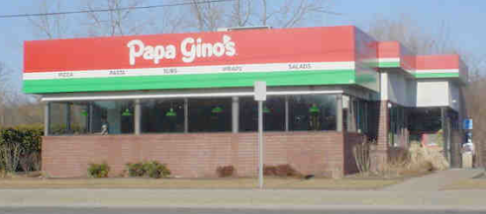
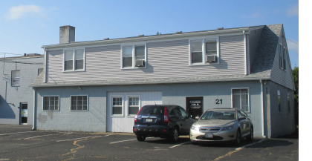
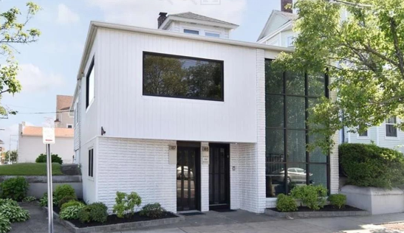
Recent Commercial Sale Examples
Business Type | Sale Price | Prior Assessment | New Assessment | % Change in Assessment
Fast-Food Restaurant | $940,000 | $697,100 | $902,400 | 1.29
Warehouse | $1,140,000 | $871,100 | $1,123,700 | 1.29
Office | $353,000 | $239,100 | $327,800 | 1.37

Slide 7
Revaluation Process in a Nutshell
Recent Sales
Take a group of properties that have recently sold representing a variety of characteristics and price ranges.
Data Files
Create a property data file of these sold properties that contains the sale prices and data about the characteristics that are key in determining value such as land size, dwelling style, size and age, among others.
Models
Apply valuation models or schedules to this file of sold properties and repeatedly refine them until the new assessed value on each sold property closely matches its sale price.
Assessments
Apply the models to the property descriptions of all properties in the Municipality and produce a set of new property assessments.

Slide 8
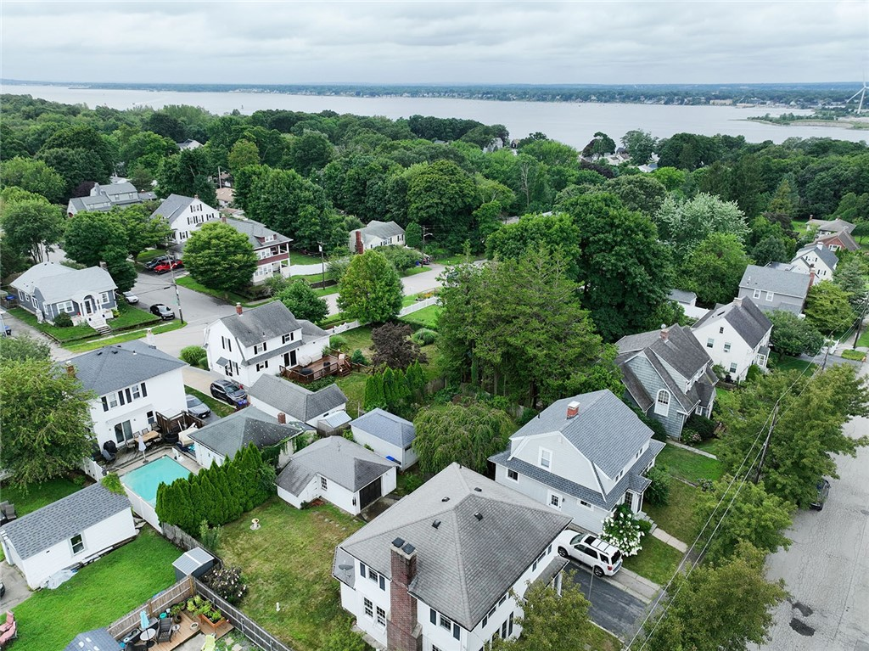
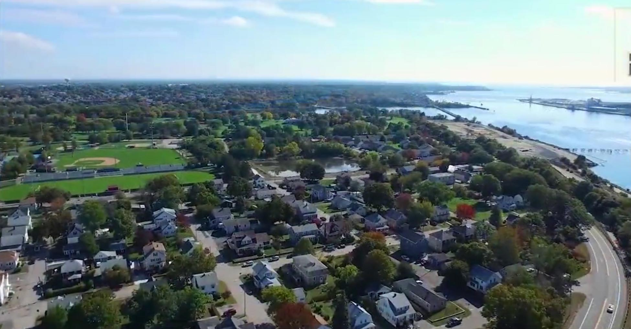
2024 Revaluation Project
Why is it important?
The Assessment Date for the City of East Providence Revaluation is 12/31/2024
The rise and fall of real estate values make certain properties more valuable or less valuable, in relation to each other.
In general, after a Revaluation, if property values have risen, the Tax Rate typically declines. If property values decrease, Tax Rates typically increase.
Since all assessed valuations are based on sales as of a certain date, later changes in the market will gradually make assessments out of step with the real estate marketplace.
When assessments are brought back into line with the market, the result is a fair distribution of the tax burden.

Slide 9
Frequently Asked Questions
Suppose I disagree with my value?
What should I bring to the hearing?
On the notice will be a phone number which you can call to arrange an Informal Hearing with our company.
Personal hearings will be made by appointment with everyone who requests one.
Any documents or evidence that supports your claim, such as recent real estate appraisals
Any documents regarding easements, wetlands, etc.
Photographs or documents that relate to structural or other problems.
Keep in Mind…
Then what happens?
No Adjustments are made at the Hearing.
All properties that have a hearing are reviewed and adjustments are made when appropriate.
The hearing officer will be discussing property values and will not have information regarding tax rates.
Those who attend a hearing will receive a notice (by mail), indicating whether their assessment has been changed, and, if so, what the new value is.
If a property owner is still not satisfied, they have the right to appeal to the East Providence Tax Assessor’s Department when they receive their Tax Bill.

Slide 10
City of East Providence, RI – 2024 Revaluation Project
City Tax Assessor’s Office
145 Taunton Avenue
City Hall - 2nd Floor
East Providence, RI 02914
401-435-7574
www.eastprovidenceri.gov
Catalis Tax & CAMA
205 Hallene Rd, Unit 213
Warwick RI 02886
401-737-0300
www.catalisgov.com

